Slide 1
ME 141
Engineering Mechanics
Portion 9
Introduction to Dynamics: Kinetics
Partha Kumar Das
Lecturer
Department of Mechanical Engineering, BUET
http://parthakdas.buet.ac.bd

Slide 2
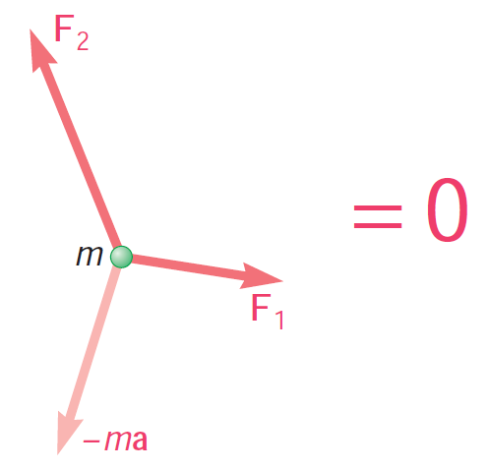
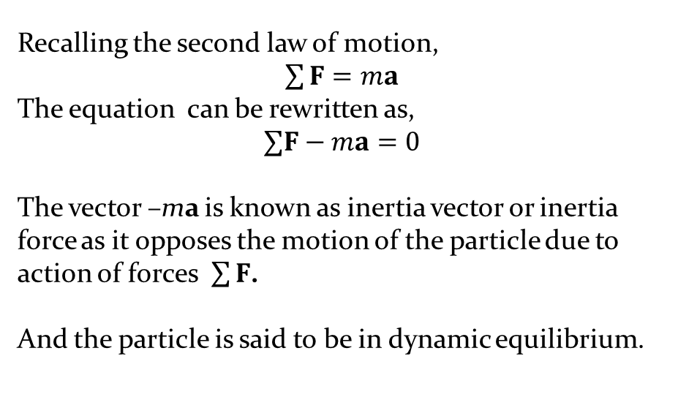
Kinetics of a Point
Dynamic Equilibrium
Recalling the second law of motion,
$\sum{F}=ma$
The equation can be rewritten as,
$$∑F−ma=0$$
The vector –ma is known as inertia vector or inertia force as it opposes the motion of the particle due to action of forces $\sum{F}$.
And the particle is said to be in dynamic equilibrium.

Slide 3
Recalling the Problem 5.1 from Portion 5 (Friction Fundamental)

Slide 4
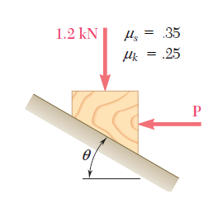
Problem 9.1
Determine whether the block shown is in equilibrium and find the magnitude and direction of the friction force when θ = 25° and
P = 750 N
P = 150 N
.30
In case of motion, determine the acceleration of the block.

Slide 5
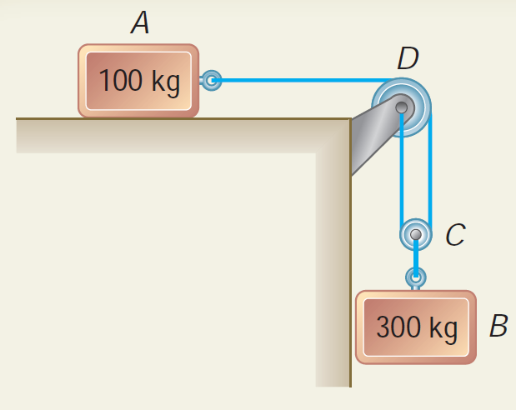
Problem 9.2 (Beer Johnston_10th edition_Ex12.3)
The horizontal plane and the pulley are frictionless, and the pulley is assumed to be of negligible mass. Determine the acceleration of each block and the tension in each cord.
Home Study:
DO the same problem considering the friction coefficients between all the surface of contacts as μs = 0.40 and μk = 0.30.
[Hint: First check the condition using μs = 0.40 whether the two pulleys are in static equilibrium or not.]

Slide 6
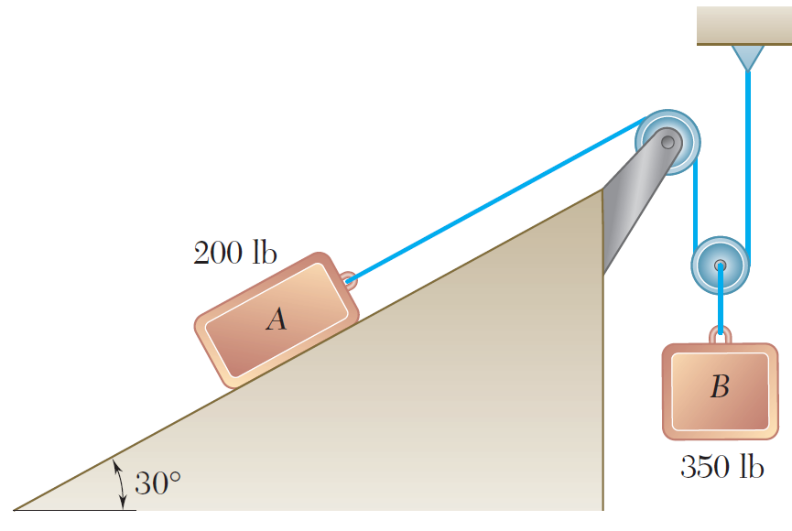
Problem 9.3 (Beer Johnston_10th edition_P12.14)
The two blocks shown are originally at rest. Friction coefficients between all the surface of contacts as μs = 0.25 and μk = 0.20. Neglecting the masses of the pulleys, determine (a) the acceleration of each block, (b) the tension in the cable.

Slide 7
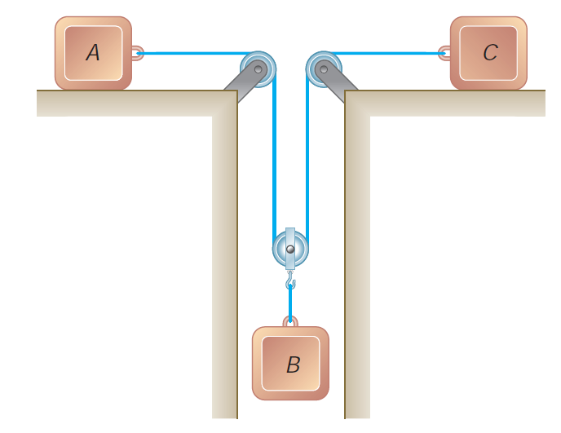
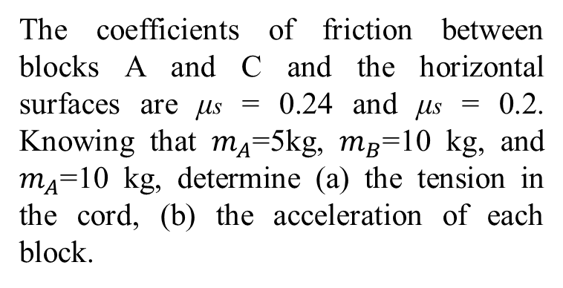
Problem 9.4 (Beer Johnston_10th edition_P12.30)
The coefficients of friction between blocks A and C and the horizontal surfaces are μs = 0.24 and μs = 0.2. Knowing that $m_{A}$=5kg, $m_{B}$=10 kg, and $m_{A}$=10 kg, determine (a) the tension in the cord, (b) the acceleration of each block.

Slide 8
References
Vector Mechanics for Engineers: Statics and Dynamics
Ferdinand Beer, Jr., E. Russell Johnston, David Mazurek, Phillip Cornwell.

